Slide 1
snapdragon
T.Dharani(1818113)
K.Sowndarya(1818153)

Slide 2
Exp no:08 Retrieving data from url
AIM:
To write a python program to retrieve data
from a url and display information about the URL.

Slide 3
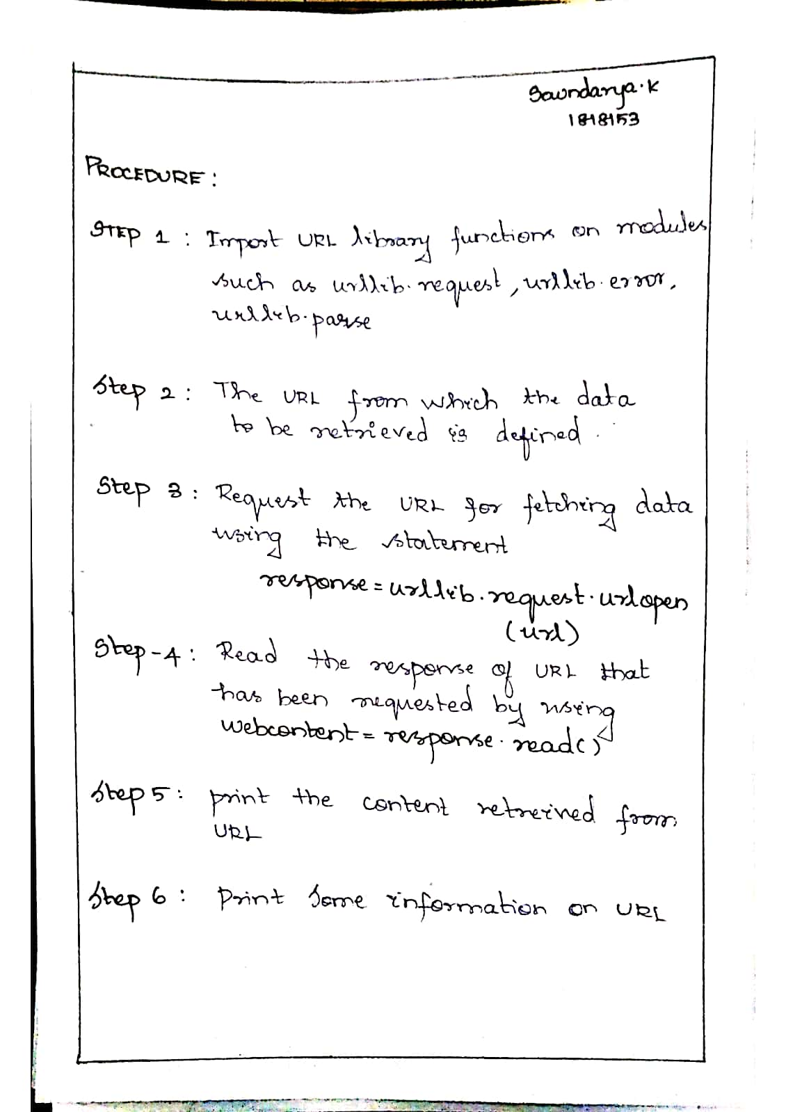

Slide 4
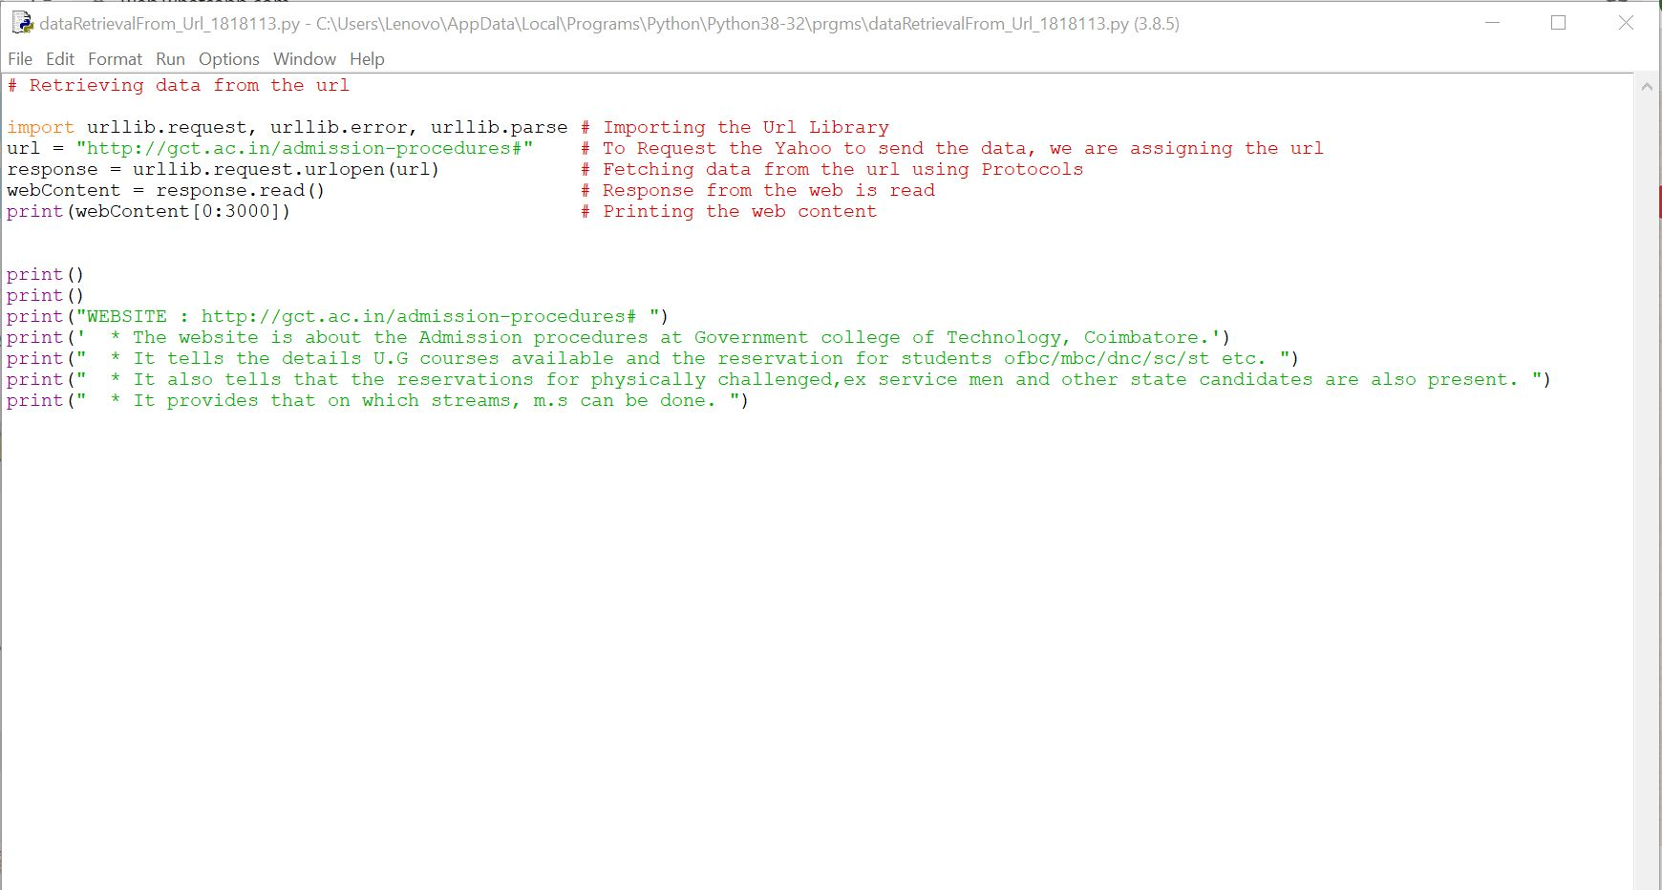

Slide 5
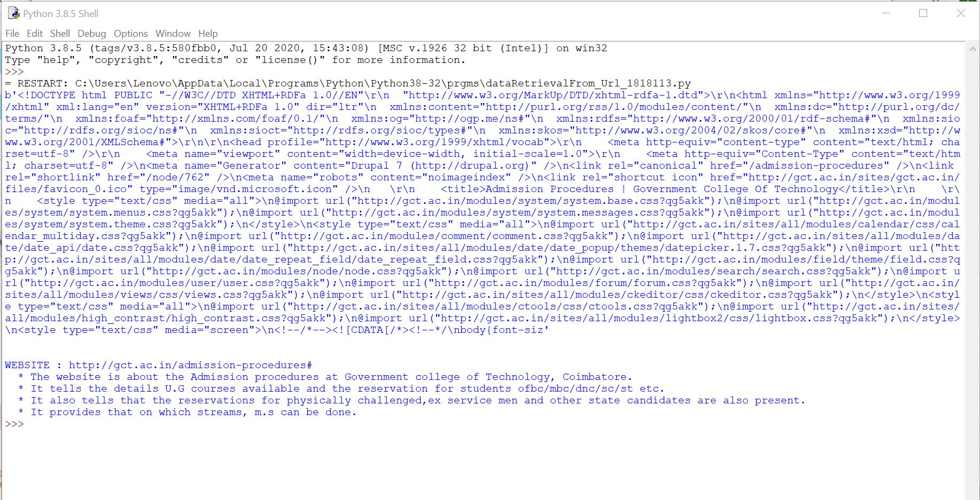

Slide 6
RESULT:
Thus, the python program to retrieve data from
the URL and to display the information about the
URL was executed successfully.

